Slide 1
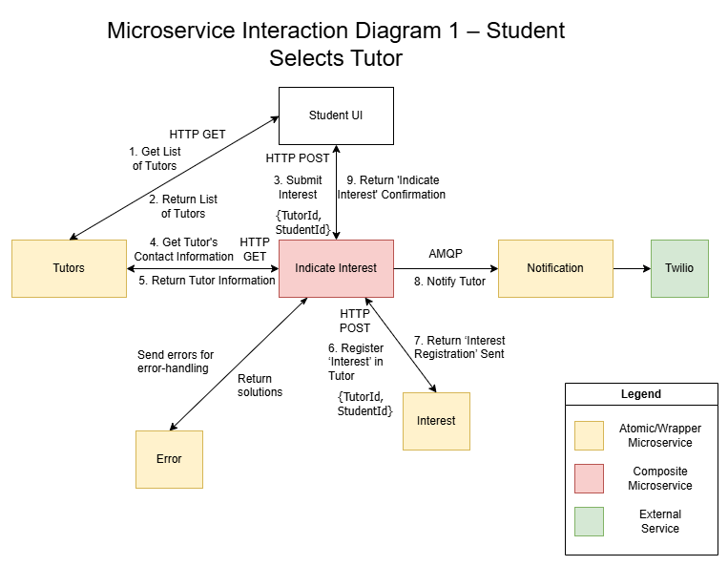
Microservice Interaction Diagram 1
– Student Selects Tutor
Notes:
Scenario 1: Student Indicates Interest (Composite & Asynchronous Notification)
Browse: The Student UI sends a synchronous HTTP GET to the Tutors atomic microservice to display the list of tutors.
Select: The student selects a tutor. The UI sends an HTTP POST with student_id and tutor_id to an Indicate Interest composite microservice.
Data Fetch: The composite service sends an HTTP GET to the Tutors service to retrieve the tutor's contact information.
Save State: The composite service sends an HTTP POST to the Interest atomic microservice to create a PENDING request in its exclusive database.
Async Event: The composite service drops an InterestCreated message (containing the contact info) into RabbitMQ.
Notify: The Notification microservice consumes the message and triggers an external email/SMS API to alert the tutor.
Business Exception: If the tutor does not reply within 48 hours, a scheduled job updates the Interest database to EXPIRED and notifies the student to try again.

Slide 2
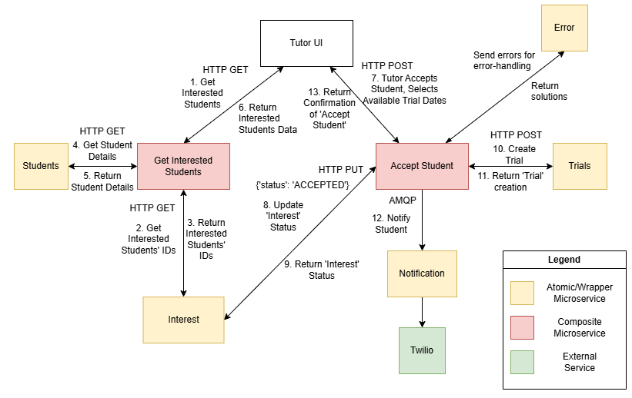
Microservice Interaction Diagram 2a
– Tutor Accepts Student, Arranges Trial Lesson
KONG API to replace ‘Get Interested Students’
BTL (?)
Notes:
Scenario 2: Tutor Reviews Interested Students (Choreography)
Review: The Tutor UI sends an HTTP GET to the Interest microservice to fetch pending requests.
Decision Input: The tutor accepts a student and selects available dates. The UI sends an HTTP PUT to the Interest microservice with {"status": "ACCEPTED", "proposed_dates": [...]}.
Update State: The Interest microservice updates the record in its database.
Choreography Trigger: The Interest microservice publishes an InterestAccepted message (containing the dates) to RabbitMQ.
Independent Reactions:
The Booking microservice consumes the message and creates a PENDING_STUDENT_CONFIRMATION record with the proposed dates.
The Notification microservice consumes the same message and emails the student to prompt their selection.

Slide 3
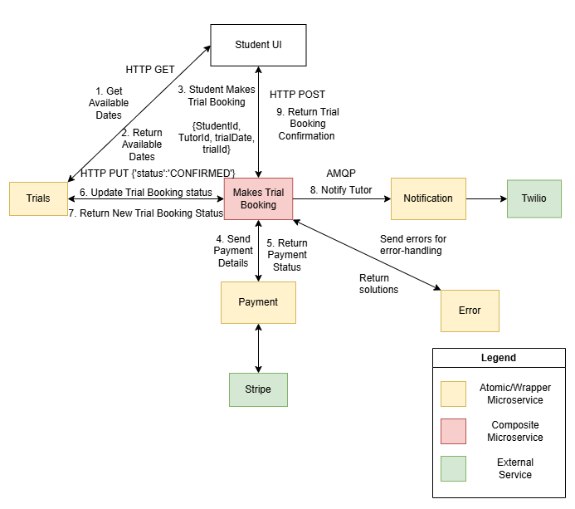
Microservice Interaction Diagram 2b
– Student Confirms Trial Lesson Booking
Notes:
Scenario 3: Booking Coordination & Confirmation (Orchestration & Rollback)
View Dates: The Student UI sends an HTTP GET to the Booking microservice to view the tutor's proposed dates.
Path A (Rollback): * The student cancels. The UI sends an HTTP PUT to the Booking microservice ({"status": "CANCELLED"}).
The Booking service frees the schedule in its DB and publishes a TrialCancelled message to RabbitMQ to notify the tutor.
Path B (Proceed to Pay): * The student selects a date. The UI sends an HTTP POST to the Booking microservice.
The Booking service temporarily locks the slot as PENDING_PAYMENT.
Payment Orchestration: The Booking service acts as an orchestrator and sends a synchronous HTTP POST to the Payment microservice.
External API: The Payment service invokes an external mock payment gateway (sandbox version) to process the transaction.
Confirmation: Upon success, the Payment service returns an HTTP 200 OK to the Booking service. The Booking service updates the status to CONFIRMED and drops a LessonConfirmed message into RabbitMQ. The Notification service emails the final calendar invite to both parties.

Slide 4
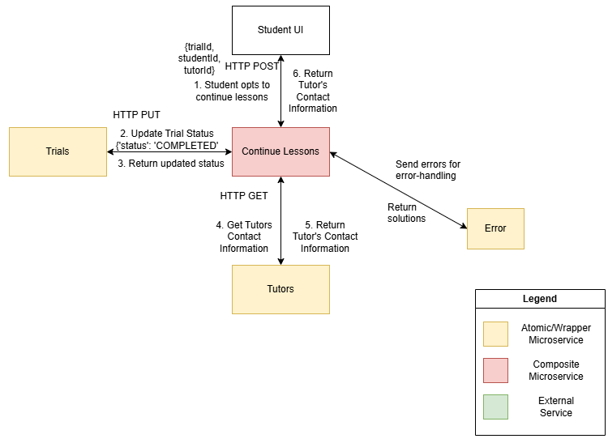
Microservice Interaction Diagram 2c
– Student continues lesson with tutor after trial lesson
Notes:
Scenario 3: Booking Coordination & Confirmation (Orchestration & Rollback)
View Dates: The Student UI sends an HTTP GET to the Booking microservice to view the tutor's proposed dates.
Path A (Rollback): * The student cancels. The UI sends an HTTP PUT to the Booking microservice ({"status": "CANCELLED"}).
The Booking service frees the schedule in its DB and publishes a TrialCancelled message to RabbitMQ to notify the tutor.
Path B (Proceed to Pay): * The student selects a date. The UI sends an HTTP POST to the Booking microservice.
The Booking service temporarily locks the slot as PENDING_PAYMENT.
Payment Orchestration: The Booking service acts as an orchestrator and sends a synchronous HTTP POST to the Payment microservice.
External API: The Payment service invokes an external mock payment gateway (sandbox version) to process the transaction.
Confirmation: Upon success, the Payment service returns an HTTP 200 OK to the Booking service. The Booking service updates the status to CONFIRMED and drops a LessonConfirmed message into RabbitMQ. The Notification service emails the final calendar invite to both parties.

Slide 5
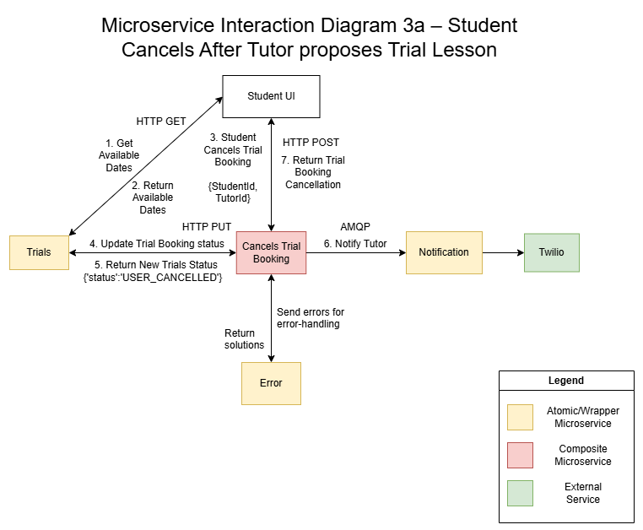
Microservice Interaction Diagram 3a
– Student Cancels after tutor proposes trial booking
Notes:
Scenario 3: Booking Coordination & Confirmation (Orchestration & Rollback)
View Dates: The Student UI sends an HTTP GET to the Booking microservice to view the tutor's proposed dates.
Path A (Rollback): * The student cancels. The UI sends an HTTP PUT to the Booking microservice ({"status": "CANCELLED"}).
The Booking service frees the schedule in its DB and publishes a TrialCancelled message to RabbitMQ to notify the tutor.
Path B (Proceed to Pay): * The student selects a date. The UI sends an HTTP POST to the Booking microservice.
The Booking service temporarily locks the slot as PENDING_PAYMENT.
Payment Orchestration: The Booking service acts as an orchestrator and sends a synchronous HTTP POST to the Payment microservice.
External API: The Payment service invokes an external mock payment gateway (sandbox version) to process the transaction.
Confirmation: Upon success, the Payment service returns an HTTP 200 OK to the Booking service. The Booking service updates the status to CONFIRMED and drops a LessonConfirmed message into RabbitMQ. The Notification service emails the final calendar invite to both parties.

Slide 6
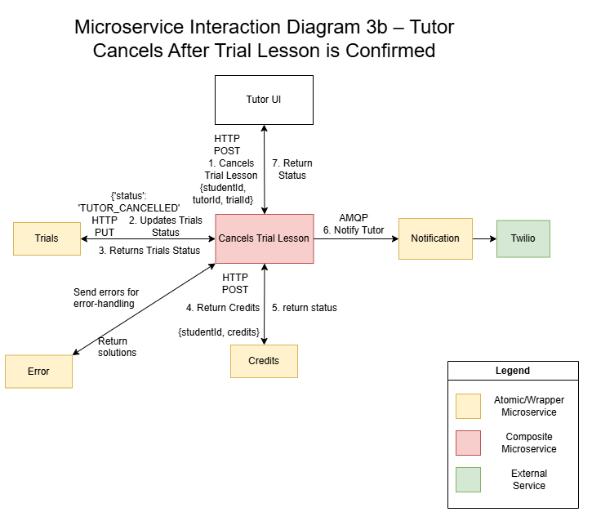
Microservice Interaction Diagram 3b
– Tutor Cancels after Trial Lesson is confirmed
6.

